Slide 1



Plant Disease Detection Using NVIDIA GPU
PRESENTED BY:
Meghana HR– 20241CAI0008

Slide 2

Plant Disease Detection Using NVIDIA GPU
AI helps detect plant diseases automatically.
Deep learning improves disease prediction.
NVIDIA GPU increases processing speed.
The system supports smart agriculture.
Early detection reduces crop damage.

Slide 3
Introduction
Plant diseases affect crop productivity.
Manual detection takes more time.
AI automates disease identification.
Image processing improves accuracy.
Smart farming increases efficiency.

Slide 4
Diseases spread quickly in crops.
Farmers face huge financial losses.
Manual monitoring is difficult.
Need for faster disease detection.
AI provides real-time analysis.
Problem Statement

Slide 5
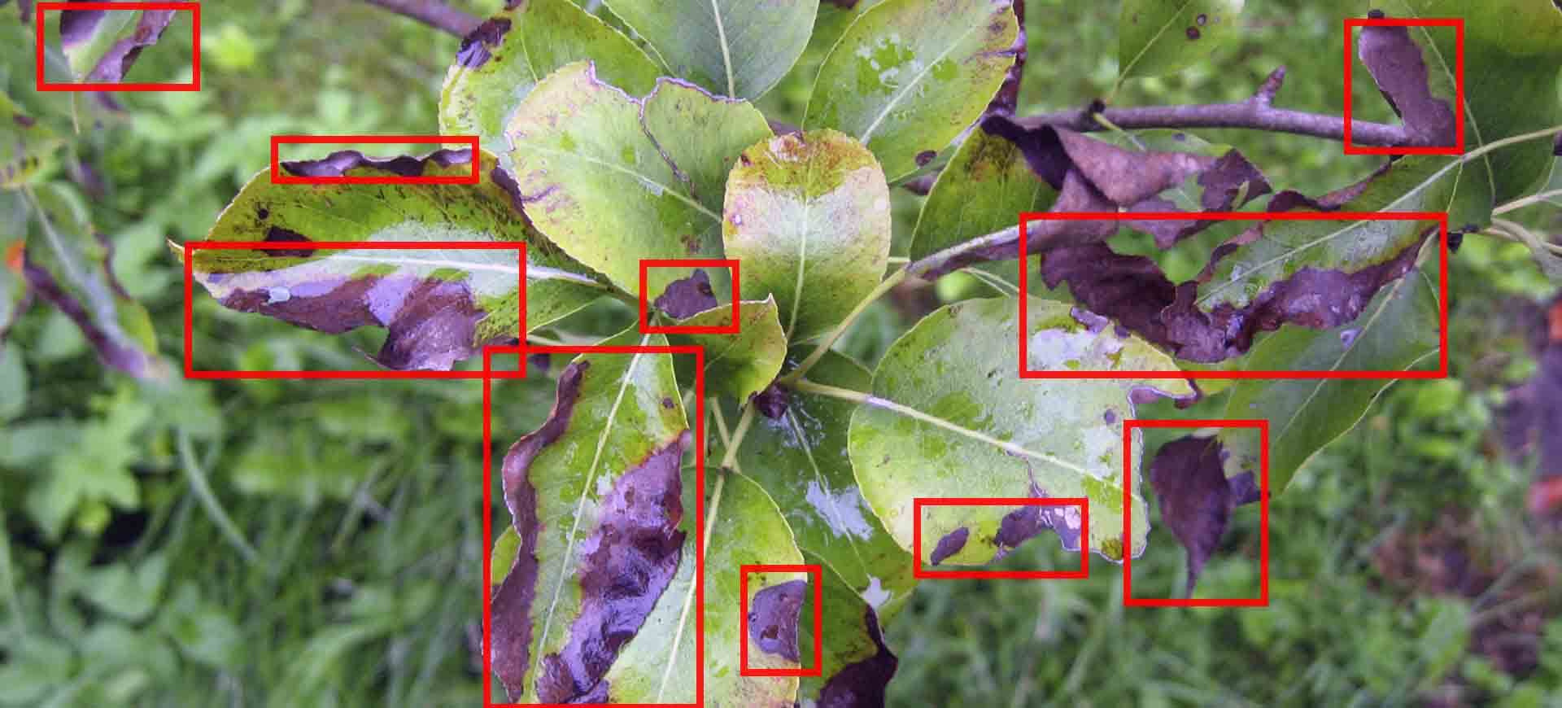

OBJECTIVES
Detect diseases from leaf images.
Objectives
Use CNN models for classification.
Improve prediction accuracy.
Reduce detection time using GPU.
Support precision farming.

Slide 6

Technology Stack
Python is used for development.
TensorFlow and PyTorch build models.
OpenCV processes images.
CNN performs disease classification.
NVIDIA GPU accelerates training.

Slide 7

Why NVIDIA GPU?
Efficient for large datasets.
GPU supports parallel processing.
Supports deep learning models.
Faster than CPU training.
Reduces execution time.

Slide 8
Dataset Used
PlantVillage dataset is used.
Contains healthy and diseased leaves.
Includes different crop categories.
Images are labeled for training.
Dataset improves model learning.

Slide 9

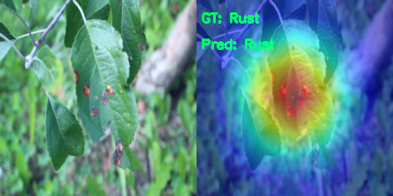
Images are resized before training.
Image processing
Image Preprocessing
Noise removal improves quality.
Normalization stabilizes training.
Data augmentation increases accuracy.
Preprocessing improves prediction results.

Slide 10
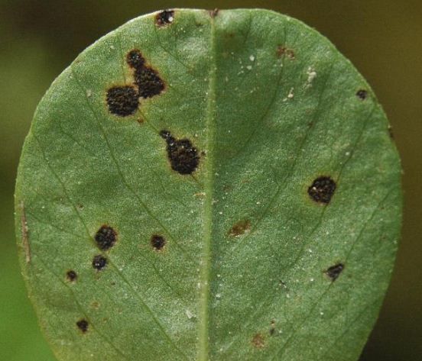

CNN MODEL
CNN is used for image classification.
Convolution layers extract features.
Pooling layers reduce dimensions.
Dense layers classify diseases.
Softmax predicts disease categories.

Slide 11
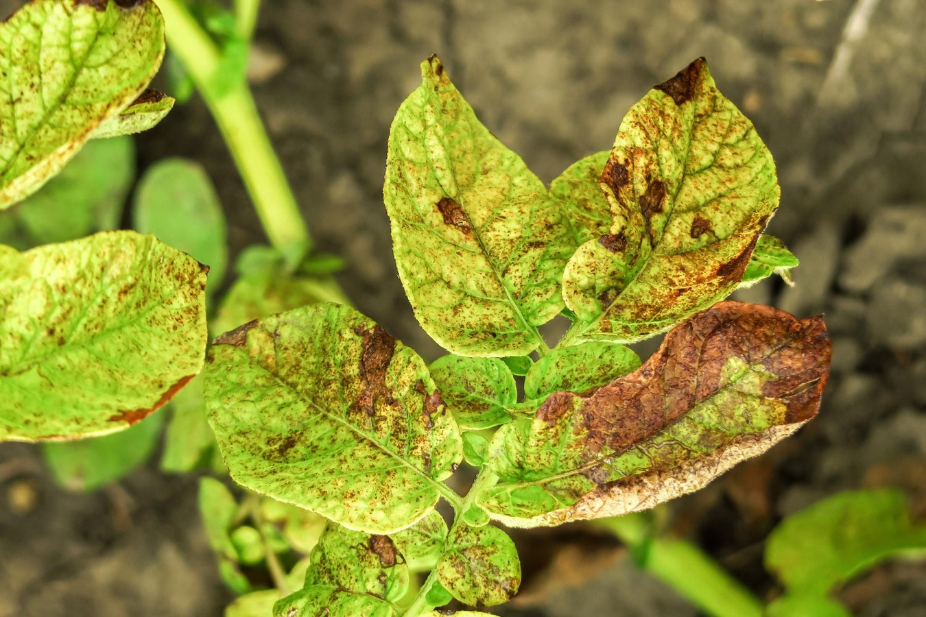
System Architecture
Leaf image is captured.
Image preprocessing is applied.
CNN analyzes disease patterns.
GPU performs fast computation.
Prediction results are displayed.

Slide 12

Advantages
Early disease detection.
Reduces crop losses.
Saves time and labor.
High prediction accuracy.
Supports smart agriculture.

Slide 13

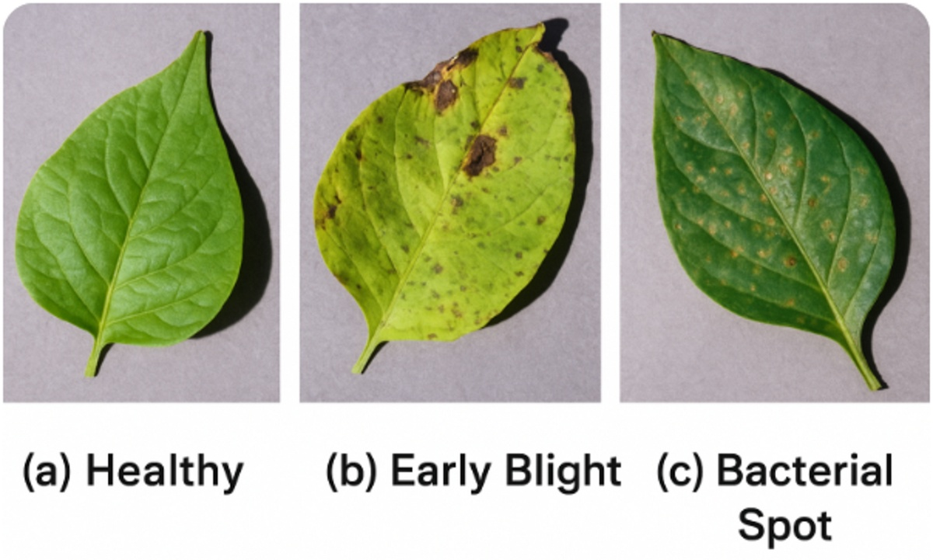
APPLICATIONS
Supports greenhouse monitoring.
Supports mobile applications.
Useful for agricultural research.
Can integrate with drones.
Used in smart farming.
Healthy
Early blight
Bacterial spot

Slide 14
Future Enhancements
IoT sensors can improve monitoring.
Cloud platforms enable remote access.
More crop diseases can be added.
Advanced AI models improve accuracy.
Mobile app integration is possible.

Slide 15
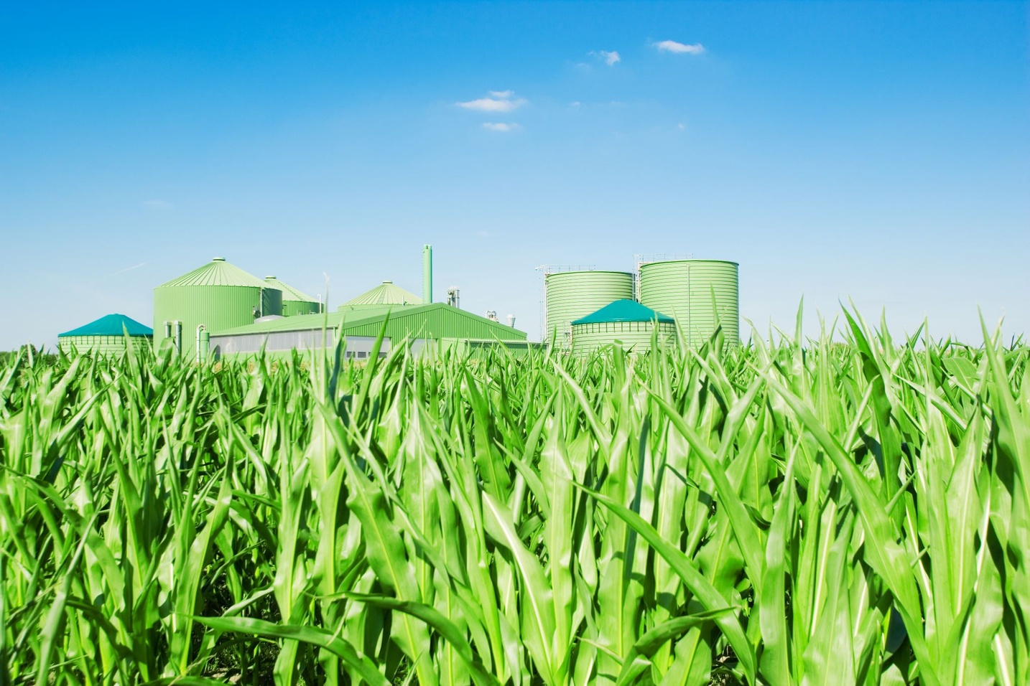
Conclusion
AI improves plant disease detection.
CNN models provide accurate predictions.
NVIDIA GPU accelerates processing.
The system reduces crop damage.
Smart farming improves productivity.

Slide 16

THANK YOU
..

